Slide 1
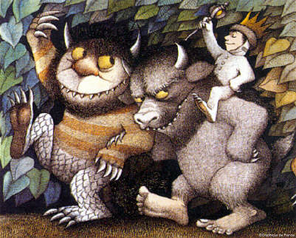
Taming Complex Data Models
@masonhale

Slide 2

DRTW (Don’t Reinvent the Wheel)
“Many of these diagrams demonstrate the rather poor GIF output of Visio.
The nice diagrams were redrawn for me by David Heinemeier Hansson.”
– Martin Fowler, January 2003
http://martinfowler.com/eaaCatalog/

Slide 3
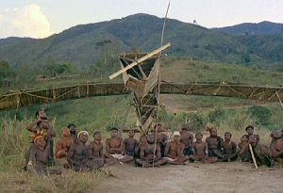
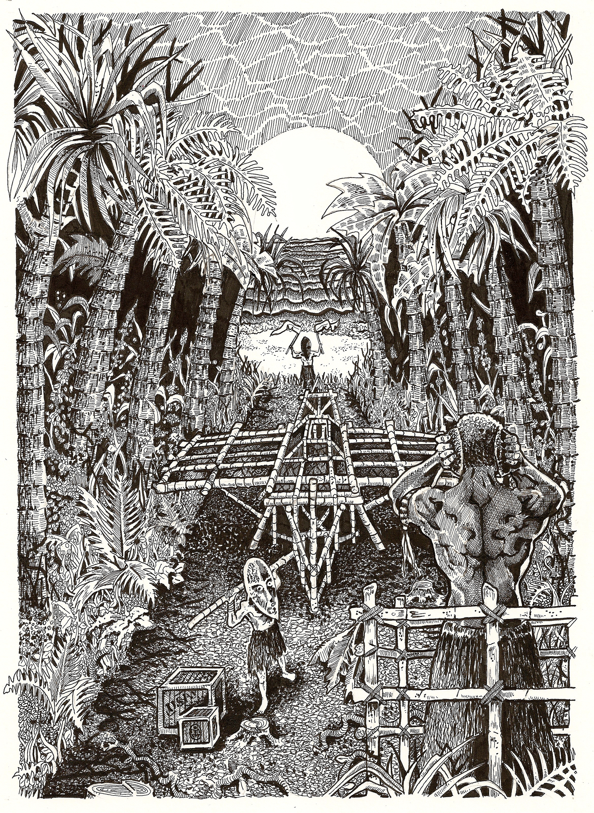
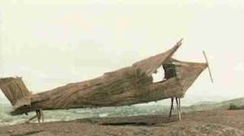
Understand Your Options (Avoid the Cargo Cult)

Slide 4
I. Hierarchies

Slide 5

Hierarchies
Problem:
Hierarchies are everywhere… but they do not naturally fit the relational model.

Slide 6
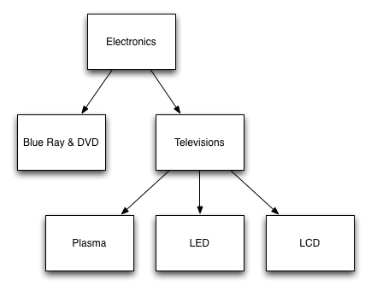
Hierarchies
Example

Slide 7
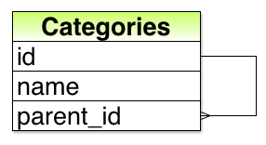
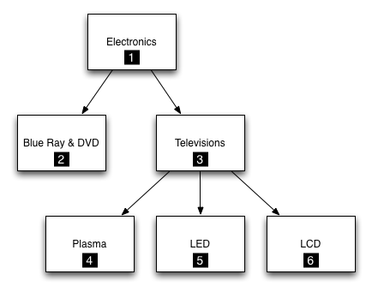
Adjacency List (acts_as_tree)
id | name | parent_id
1 | Electronics | NULL
2 | Blue Ray & DVD | 1
3 | Televisions | 1
4 | Plasma | 3
5 | LED | 3
6 | LCD | 3

Slide 8
Adjacency List (acts_as_tree)
category.children
has_many :children, :class_name=>’Category’, :foreign_key=>’parent_id’
=> SELECT * FROM categories WHERE parent_id = #{self.id}
category.descendents
=> children + children.collect(&:descendents) # recursive!
category.parent
belongs_to :parent, :class_name=>’Category’, :foreign_key=>’parent_id’
=> SELECT * FROM categories WHERE id = #{self.parent_id}
category.ancestors
[self.parent] + parent.ancestors # recursive!

Slide 9
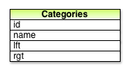
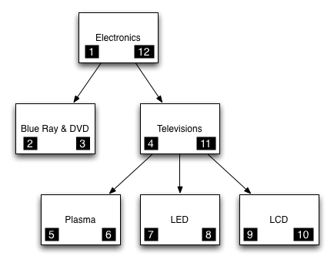
Nested Set (acts_as_nested_set*)
id | name | lft | rgt
1 | Electronics | 1 | 12
2 | Blue Ray & DVD | 2 | 3
3 | Televisions | 4 | 11
4 | Plasma | 5 | 6
5 | LED | 7 | 8
6 | LCD | 9 | 10
* https://github.com/collectiveidea/awesome_nested_set

Slide 10
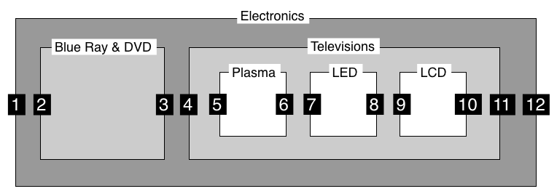
Nested Set (acts_as_nested_set)

Slide 11
Nested Set (acts_as_nested_set)
category.descendents
SELECT * FROM categories WHERE lft > #{self.lft} AND rgt < #{self.rgt} ORDER BY lft
category.ancestors
SELECT * FROM categories WHERE lft < #{self.lft} AND rgt > #{self.rgt} ORDER BY lft
category.parent
SELECT * FROM categories WHERE lft < #{self.lft} AND rgt > #{self.rgt} ORDER BY rgt LIMIT 1

Slide 12
Comparison
 | Shallow Query | Deep Query | Update | Ordered?
Adjacency List | Fast + Simple | Slow + Complex | Fast + Simple | No*
Nested Set | Fast + Complex* | Fast + Simple | Slow + Complex | Yes

Slide 13
But wait… there’s more
SQL-99 specifies support for in-database recursive queries – WITH RECURSIVE ()
Rails support added in Arel 2.1
Database support:
PostgreSQL 8.4 (acts_as_sane_tree),
Oracle 11g, MS SQL Server, IBM DB2, Firebird
https://github.com/rails/arel/pull/23
https://github.com/chrisroberts/acts_as_sane_tree

Slide 14
But wait there’s more…
Materialized Paths / Label Trees
ex: Top.Countries.Europe.Russia
Graph Databases
Neo4j http://neo4j.org/
FlockDB https://github.com/twitter/flockdb
http://www.postgresql.org/docs/9.1/interactive/ltree.html

Slide 15
II. Aggregations

Slide 16
Aggregations
Problem:
Reports often collect statistics on aggregate data, often with complex query logic.

Slide 17
Aggregations
Example:
Total and average sales by
Product
Product Category
Region
Department
Salesperson
Time period (Month, Quarter, Year)
or any combinations of the above

Slide 18
ActiveRecord::Calculations
class Region < ActiveRecord::Base
def total_sales
Order.sum(:total_price, :conditions=>{:region_id=>self})
end
end

Slide 19
Database View
CREATE VIEW product_sales_by_region
AS SELECT region_id, product_id,
sum(total_price),
min(total_price),
max(total_price),
avg(total_price)
FROM orders
GROUP BY region_id, product_id

Slide 20
Database Views
# as far as Rails is concerned a View is just a table
class ProductSalesByRegion < ActiveRecord::Base
belongs_to :region
belongs_to :product
end
class Region < ActiveRecord::Base
has_many :sales_by_product, :class_name=>’ProductSalesByRegion’, :readonly=>true
end
class Product < ActiveRecord::Base
has_many :sales_by_region, :class_name=>’ProductSalesByRegion’, :readonly=>true
end

Slide 21
Sets of Aggregations
Product | East | North | South | West
Product 1 | $200 | $400 | $300 | $500
Product 2 | $150 | $200 | $300 | $450
Product 3 | $250 | $250 | $200 | $350
Product 4 | $100 | $50 | $150 | $150
ProductSalesByRegion.all
ProductSalesbyRegion.where(:region_id=>[1,2,3,4,5])

Slide 22
Questions?

